Slide 1
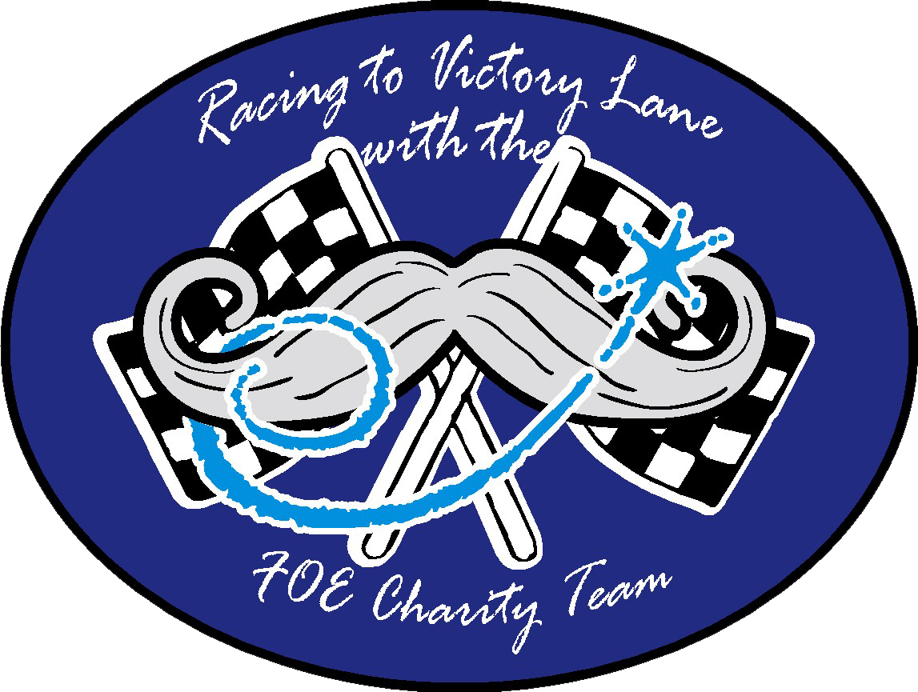
Time For A Tune Up

Slide 2
Strong Communication is Key
Complacency is one of the greatest threats to long-term success.
It is easy to become comfortable doing things the way we have always done them, especially when those methods have worked in the past. But what worked yesterday may not be what moves us forward tomorrow.
If we want our Aeries and Auxiliaries to grow, improve, and remain strong for future generations, we have to be willing to challenge ourselves to do more.
Success requires progress, and progress requires change.

Slide 3
”We’ve Always Done It That Way”
If you have been an Eagle for any length of time, you have probably heard the phrase:
  “We’ve always done it that way.”
Sometimes tradition is important. Our traditions connect us to the Brothers and Sisters who built this organization and created the foundation we stand on today. But tradition should never become an excuse to stop improving.
Instead of asking, “How have we always done this?” we should also ask:
  “Is there a better way?”

Slide 4
Don’t Settle for Good Enough
Being satisfied with the way things are can prevent us from seeing what they could become.
A successful event can become an even better event.
A good membership program can reach more people.
A strong community project can have an even greater impact.
A good leader can continue learning and become an even better leader.
Our goal should never simply be to maintain. We should always be looking for opportunities to improve.

Slide 5
Better Ourselves to Better Our Organization
Improving our Aeries and Auxiliaries starts with improving ourselves.
Every officer, member, committee chair, and volunteer has an opportunity to learn something new and bring that knowledge back to the organization.
We can become better listeners.
Better communicators.
Better recruiters.
Better mentors.
Better volunteers.
Better leaders.
When individuals grow, the organization grows with them.

Slide 6
Be Willing To Try Something Different
Trying something new does not mean abandoning everything that has worked in the past.
It means being willing to experiment.
Maybe it is a new type of membership event.
A different way of communicating with members.
A new fundraising idea.
A stronger social media presence.
A different approach to welcoming new members.
A new way of involving younger members.
Not every new idea will work, but we will never discover better ideas if we are afraid to try.

Slide 7
Set Bigger Goals
Sometimes we limit ourselves by setting goals based only on what we accomplished last year.
If we raised $10,000 last year, why not challenge ourselves to raise $12,000?
If we brought in 25 new members, why not aim for 35?
If 50 people attended an event, what could we do differently to bring in 75?
Goals should challenge us.
They should give our members something meaningful to work toward.
A bigger goal creates a bigger reason to work together.

Slide 8
Honor the People Who Came Before Us
The Fraternal Order of Eagles became what it is today because generations of Brothers and Sisters refused to settle.
They built Aeries and Auxiliaries.
They recruited members.
They supported communities.
They raised money for important causes.
They fought for ideas they believed could improve people's lives.
The best way to honor their work is not simply to preserve what they built.
It is to continue building upon it.

Slide 9
Leadership Means Moving Forward
Leadership is not just about managing what already exists.
Leadership means helping people see what is possible.
It means asking questions. Encouraging ideas. Listening to members. Taking calculated risks. Learning from mistakes. And giving people the confidence to try something new.
Strong leaders do not say, “That is the way we have always done it.”
Strong leaders ask:
  “How can we make it better?”

Slide 10
Make the Most of Your Year
Every year gives us a limited amount of time to make a difference.
Do not let the year pass simply repeating the same activities and expecting different results.
Choose one thing your Aerie or Auxiliary can improve.
Choose one new idea to try.
Choose one goal that stretches your organization beyond what it accomplished last year.
Small improvements, repeated over time, can create tremendous change.

Slide 11
We Deserve More!
Our organization deserves more than complacency.
It deserves ambition. It deserves creativity. It deserves strong leadership and bigger goals.
And it deserves members who are willing to continue the work started by the Brothers and Sisters who came before us.
This year, challenge yourself and challenge your Aerie or Auxiliary.
Try something new. Raise the bar. Find a better way.
Because the future of the Fraternal Order of Eagles will not be built by simply doing what we have always done. It will be built by people who are willing to lead us toward what comes next.

